Slide 1

Modeling and Monitoring social media dynamics to predict short-term peak electricity demand
Isabella Nunes Grieser, T. Gebhard, A. Tundis, J. Kersten, T. Elßner, F. Steinke

Slide 2
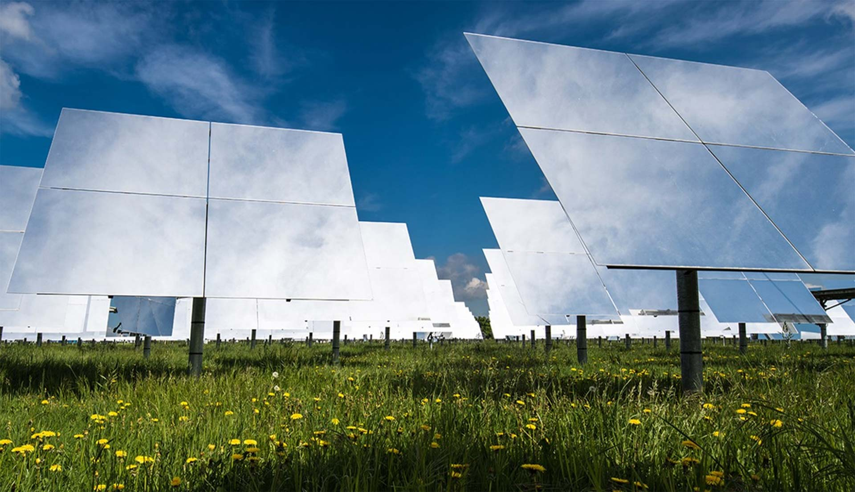
Motivation
Bildquelle hier angeben

Slide 3
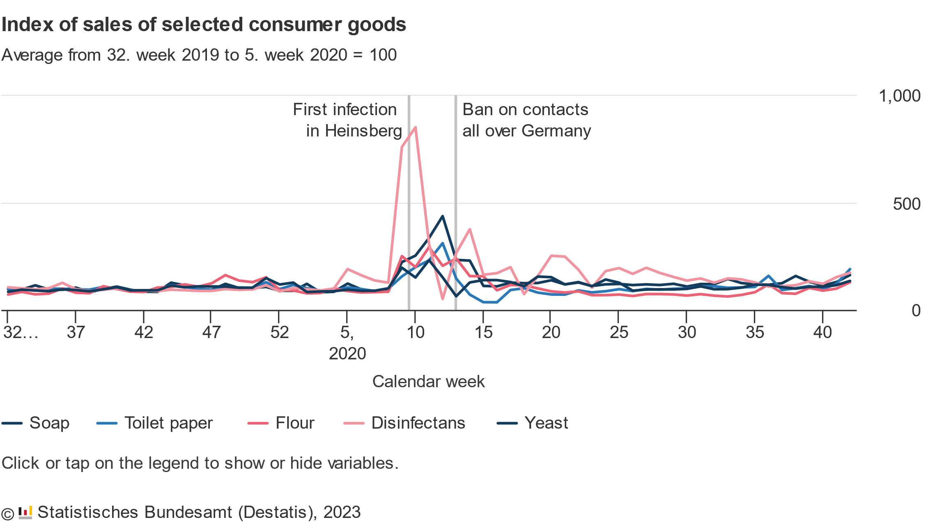
Panic Buying and Overconsumption became a prominent topic during the COVID-19 Pandemic
Panic Buying: When consumers buy unusually large amounts of a product due to a (perceived) crisis
During the COVID-19 Pandemic: People bought much greater number of disinfectants and soap in fear of the infectious disease.
Panic was amplified due to Information on Social Media
3
Federal Statistical Office of Germany (Destatis), 2023
Notes:
During the COVID-19 pandemic, a significant part of the population stockpiled on essential goods such as disinfectant, soap or toilet paper.
This was caused bz a phenomenom called panic buying, where consumers buy an unusual amount of specific goods due to a specific crisis, which can be imagined or not
Panic buying occured dring the COVID 19 pandemic, but there were other instances of it occuring in the past, for example to prepare for hurricanes.
One of the reasons for panic buying was social media. Consumers see articles from news sites of shortages or see posts from friends about their own experiences in the shortage and get affected by them, feeling the pressure of the situation and forcing them to act and to stockpile
Social media induced panic buying onlz occured with physical goods. But ➔ Could it also affect critical infrastruture such as the power grid?
Until now, there seems to be no mjor incidents where social media cause significant changes in power demand.
However, there are some scenarios where this could happen.

Slide 4
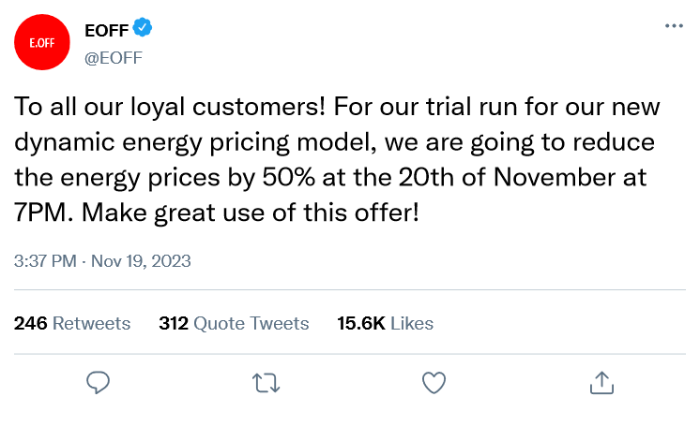

One Example Scenario where Information on Social Media could affect Power Demand
Demand Response Scenario:
Malicious actors compromise the social media channels of an electricity company
spread the false advertisement of significantly reduced electricity prices for a limited time
However: other scenarios could be imagined…
Notes:
One scenario analysed in this work is the demand response scenario:
In this scenario: utility company uses dynamic pricing to adapt energy prices to changes in energy supply. They use social media to communicate price changes
But: if malicious actors take control of social media channels and spread the misinformation that the electricity prices will be significantly reduced for a certain amount of time
If consumers are encouraged to use more energy at a time where the demand is already high ➔ risk of overstraining the grid ➔ possible blackout
This is the scenario that we analysed in our work ➔ but: other scenarios could be imagined

Slide 5
Related Works
Current Research focuses on how to model changes in the power grid based on information on social media and how it could affect the power grid
Different social media-based attack strategies against the power grid [1]
Application of a multi-level influence propagation model to model differing “gullibility” of consumers [2]
However:
No usage of real-world data
No proposals on how to detect potentially critical electricity demand behavior for the power grid
➔ Our approach!
[1] Pan, Tianyi, et al. "Threat from being social: Vulnerability analysis of social network coupled smart grid." IEEE Access 5 (2017): 16774-16783.
[2] Tang, Daogui, et al. "Analysis of the vulnerability of smart grids to social network-based attacks." 2018 3rd International Conference on System Reliability and Safety (ICSRS). IEEE, 2018.
Notes:
Current research mostly analyses the question TODO

Slide 6
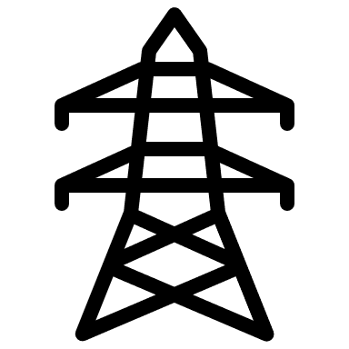


Current Approach for Load Imbalance: Selectively cut consumers off
Current countermeasures for a possible social-media based increase in power demand?
Load Shedding
Interrupt the delivery of electricity to selected entities
To prevent overstraining the power grid
Reactive approach to the problem
Could we change this reactive approach to a pro-active approach?
Notes:
Current research mostly analyses the question

Slide 7


Proposal for a Monitoring Framework
Monitoring Framework:
Source: Wikipedia
Detect Social Media Events that may impact Power Demand
Collect Social Media Posts related to the Scenario
Estimate
Speed of Information Spread
Run Simulation of Power Demand with the Estimated Speed
Predict Critical Power Demand Trend
Source: Wikipedia
…
Notes:
We propose a framework to monitor and warn of such changes in power consumption based of social media posts in advance
Framework has 5 steps:
Detect Social Media Events that could possibly impact the Power Demand
Social media posts that are connected to the relevant to the specific scenario and their timestamps are collected. This can be done with either keyword search or natural language processing.
Estimate the speed of the information spread over the social network
We run the simulation with our proposed model with the estimated speed of information spread
Analyse if the simulated power demand exceeds the power demand that the power grid infrastructure can handle

Slide 8
Modeling the Impact of Social Media on Power Consumption
Bildquelle hier angeben
Notes:
First: introduce our proposed model to model the impact of social media on the power consumption

Slide 9
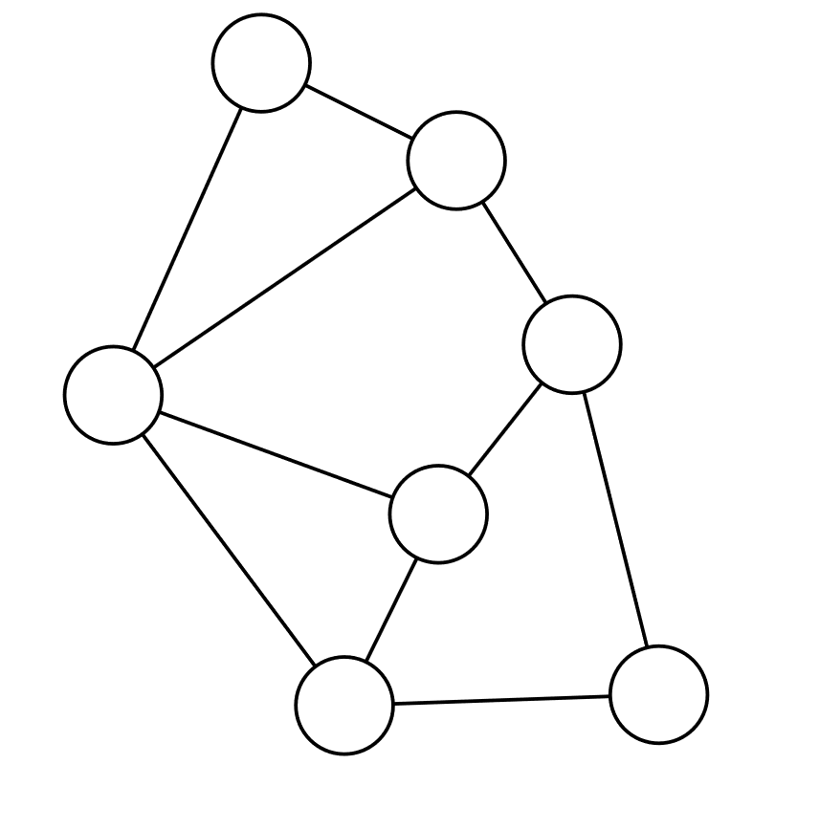
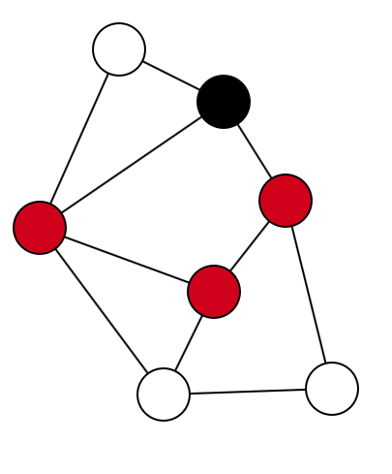
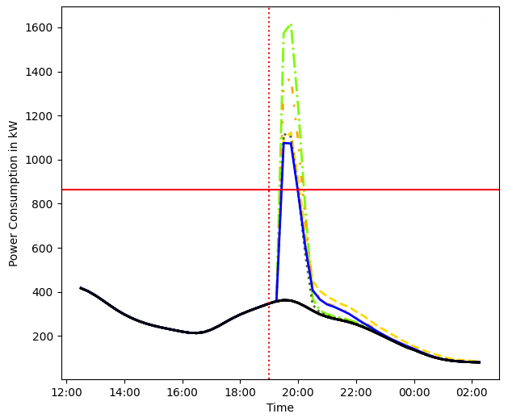
The Model is divided into three Components
Social Media Graph
Information Propagation Model
Power Demand Change
Notes:
The model can be divided into three components:
We create a social network where entities consume electricity and change their power consumption depending on the information on social media.
We use an information propagation algorithm to model the information propagation process through the social network an to analyze which entities know the information at a given time.
We define the rules and assumptions about how the information affects the energy consumption of the entities in the system

Slide 10
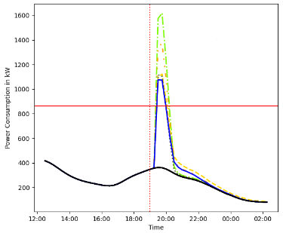
Graph-Based Social Network Modelling and Information Propagation
Graph model used to model social media networks ➔ Barabási–Albert model
Small world
Scale-free
Highly clustered
The SIR model is used to model the information propagation process:
Three states:
Susceptible (S)
Infected (I)
Recovered (R)
Notes:
First, we use a graph model to model the social connections between the entities in the system
The graph is generated randomly
The random graph used is the barabasi albert model
Because: it is a small word graph, it is scale free and it is a clustered graph ➔ the same characteristics as real networks
Next, we use an epidemiological model, the SIR model, to model the spread of information over the network
➔ We see the information as an infection that is spread over the network.
In the SIR model, entities in the network can have one of 3 states
- Susceptible: entites do not know of the information
- Infected: entities know of the information and act on it
- Recovered: entities know of the information but do not believe in it and do not act on it anymore
Entities can change their state over time

Slide 11

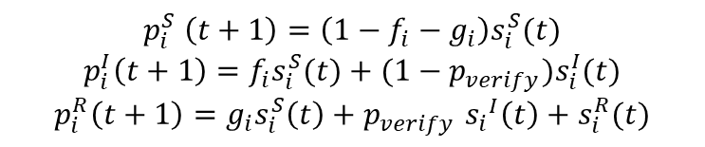





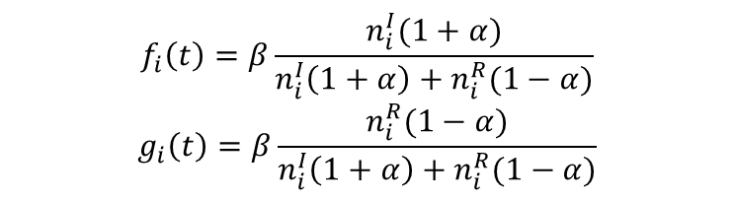
Infection-based Information Propagation Algorithm
State Chart:
$${1−g}_{neighbors}−f_{neighbors}$$
Susceptible
$$g_{neighbors}$$
$$f_{neighbors}$$
Recovered
Infected
$$p_{verify}$$
$$1$$
$$1−p_{verify}$$
$$p_{i}^{S} \left(t+1\right)=\left(1−f_{i}−g_{i}\right)s_{i}^{S}(t)$$
$$p_{i}^{I}\left(t+1\right)=f_{i}s_{i}^{S}(t)+(1−p_{verify})s_{i}^{I}(t)$$
$$p_{i}^{R}\left(t+1\right)=g_{i}s_{i}^{S}\left(t\right)+p_{verify} {s_{i}}^{I}\left(t\right)+s_{i}^{R}(t)$$
$$f_{i}\left(t\right)=β\frac{n_{i}^{I}(1+α)}{n_{i}^{I}\left(1+α\right)+n_{i}^{R}(1−α)}$$
$$g_{i}\left(t\right)=β\frac{n_{i}^{R}(1−α)}{n_{i}^{I}\left(1+α\right)+n_{i}^{R}(1−α)}$$
Notes:
Here you can see the state chart of the entities. All entities start in the susceptible state, and
may either become infected or switch to the recovered state.
Infected entities can recover and recovered entities do not change their state
Below you can see the probabilities that an entity changes their state to another state. It is largely dependend on which state its neighbors have
If most neighobrs are infected, the entity becomes infected
If most neighbors are recovered, the entitiy will recover

Slide 12
Rule-Based Calculation of the Power Consumption
Assumptions
Each node in the social media graph represents one (physical) household
Only infected entities change their electricity demand
The effect of the information may have a delayed response on the electrical grid
Power Calculation
Power usage is computed as the normal power consumption + the additional demand
Normal power consumption given by standard load profiles
Each household may have electrical appliances given their adoption rate
If appliance is turned on ➔ constant power consumption
Notes:
Multiple assumptions were made for the rule-based calculation of the power consuption.
The most important ones are shown here. These are:
- Each node in the social media graph represents one (physical) household
- Only infected entities change their electricity demand, not susceptible or recovered entities
- The effect of the information may have a delayed response on the electrical grid
The basic simulation steps are that:
- the simulation is initialized with one entity considered infected, all other are susceptible
- for each iteration step:
- Calculate the power used in the network
Spread the information in the graph

Slide 13
Estimation Algorithm for the Information Spread with Social Media Data
Bildquelle hier angeben

Slide 14


Social Media Data can be used to estimate Model Parameters
Assumption
Number of relevant social media posts correlates with the total number of infected entities
However: the graph-based algorithm calculates the local spread of infection
➔ Estimate the global infection process of the graph-based algorithm
Differential Equations:
$$\frac{dS}{dt}=−\frac{kβ}{N}∙S(t)$$
$$\frac{dI}{dt}=\frac{kβ}{N}∙\frac{I\left(t\right)\left(1+α\right)}{I\left(t\right)\left(1+α\right)+R\left(t\right)\left(1−α\right)}∙S\left(t\right)−p_{verify}∙I(t)$$
$$\frac{dR}{dt}=\frac{kβ}{N}∙\frac{R\left(t\right)\left(1−α\right)}{I\left(t\right)\left(1+α\right)+R\left(t\right)\left(1−α\right)}∙S\left(t\right)+p_{verify}∙I(t)$$
➔ Solve for $α, β, p_{verify}, S(0), I\left(0\right), R(0)$
Count Social Media Posts over a Timespan
Minimize
$${(I\left(t\right)−n_{posts}\left(t\right))}^{2}$$
Solve Differential Equations
Notes:
We use social media data to analyze the speed and extent of information spread through the social network
We have multiple assumptions:
2. Number of relevant social media posts correlates with the number of infected entities
However, this assumption has one problem: we assume that the number of posts show the number of infected entities in the whole system
But: the graph-based algorithm has a local view on the number of infections ➔ each node only knows the number of infections of its neighbors
So, we transform the graph-based model to a model that calculates the global number of infections and estimate the parameters of the global model
and then using the parameters of the global model on the graph-based model. For this we need to make various assumptions to generalize the graph
Algorithm and the graph itself.
The global model is given with the differential equations
The estimation algorithm has 4 basic steps:
Count the number of Social Media Posts over a given Timespan
Smooth the data plot of the number of social media posts over time with a filter
Minimize the difference between the infection process of the SIR model and the number of social media posts
For each minimization step: solve the differential equations to get the number of infected entities calculated by the SIR model

Slide 15
CASE Study: Social Media Misinformation Risks in Dynamic Energy Pricing
Bildquelle hier angeben

Slide 16
One Example Scenario where Information on Social Media could affect Power Demand
Recap
Demand Response Scenario:
Malicious actors compromise the social media channels of an electricity company
spread the false advertisement of significantly reduced electricity prices for a limited time
However: other scenarios could be imagined…
Notes:
One scenario analysed in this work is the demand response scenario:
In this scenario: utility company uses dynamic pricing to adapt energy prices to changes in energy supply. They use social media to communicate price changes
But: if malicious actors take control of social media channels and spread the misinformation that the electricity prices will be significantly reduced for a certain amount of time
If consumers are encouraged to use more energy at a time where the demand is already high ➔ risk of overstraining the grid ➔ possible blackout
This is the scenario that we analysed in our work ➔ but: other scenarios could be imagined

Slide 17
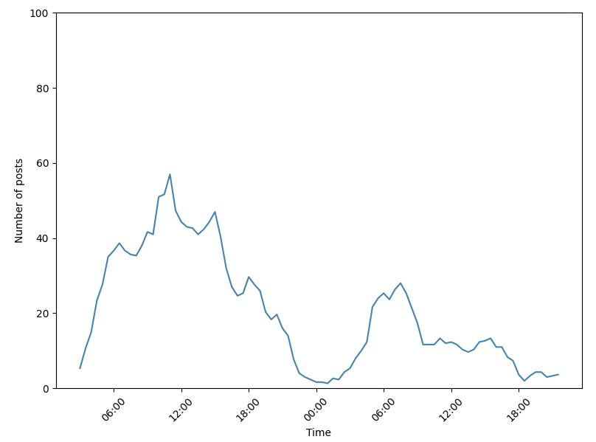
Idea: Use similar, but unrelated information propagation event dataset to estimate realistic model parameters
Social Media Dataset:
Grunewald fire: Fire caused by an explosion in Grunewald, Berlin on August 4th, 2022
Twitter posts and their timestamps gathered between August 4th, 2022, and August 5th, 2022
Posts contained the keywords ” Grunewald”, ”fire”, ”explosion”, or ”bomb”
In total: 1759 tweets
Information propagation progress over time for the Grunewald dataset
Notes:
Since there are no known examples of social media information spreading events causing significant changes in electricity consumption from what we know, and since we focus on possibly perceived crisis events that occur in a relatively short time span
➔ We use a similar, but unrelated data set to estimate the propagation of information of these types of events
We assume that these events spread in a similar manner
Social media event that we used: Grunewald fire: fire caused by an explosion in Grunewald in August 4th 2022
We gathered posts between August 4th and August 5th
Collected all posts that contained the words Grunewald, fire, explosion or bomb
In total: 1759 tweets
Tweets were aggregated to count the number of tweets every 30 mins

Slide 18
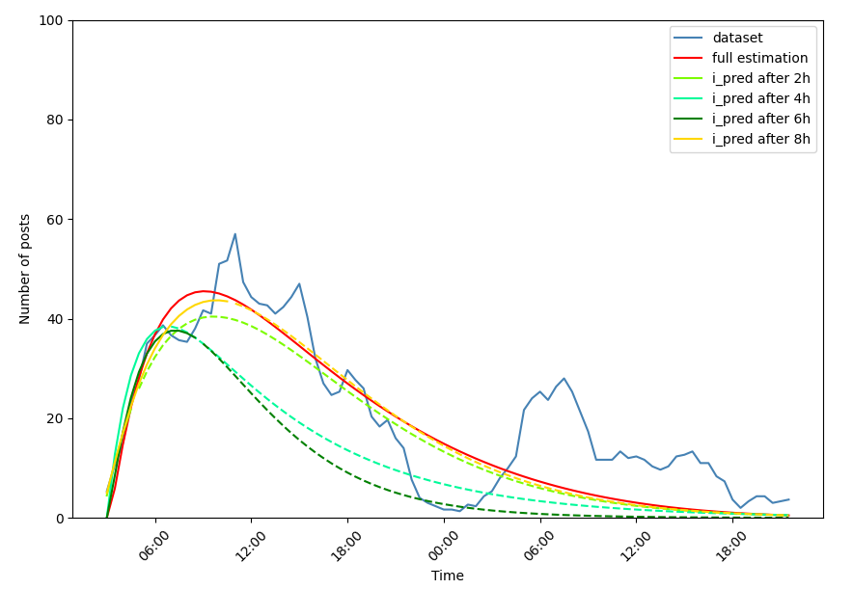
Idea: Use similar, but unrelated information propagation event dataset to estimate realistic model parameters
Parameter estimation results with variable data input size
Notes:
We run the parameter estimation algorithm on the dataset with different sizes of the dataset to analyse how well the estimation algorithm works when the information propagation event is still ongoing
The blue plot is the number of posts over time and the different colors are the estimated information propagation process with the data gathered after a certain number of hours after the start of the event
Looking at the plot, it can be seen that the estimated algorithm estimates reasonable information propagation process, even if the event is still ongoing and we do not have the full dataset
However, it cannot model the drop in posts that happens over night ➔ the algorithm is more suitable for information propagation events that happen during one single day

Slide 19
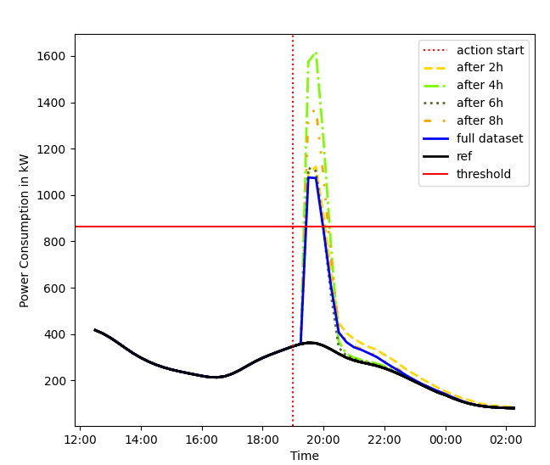
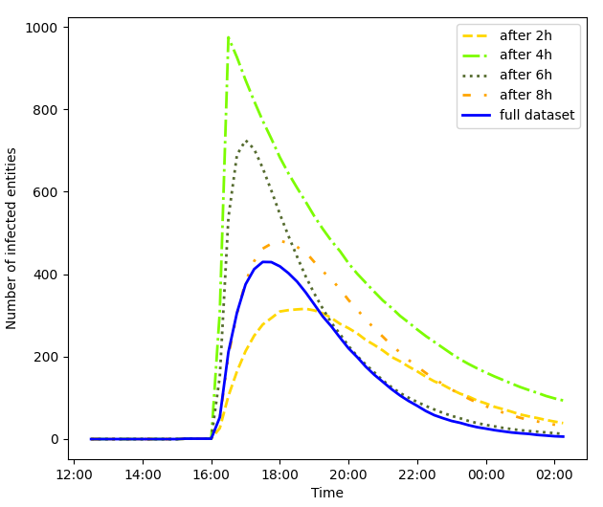
Simulated Infection Process and Power Consumption
Simulated excess power consumption for different estimated information propagation parameters
Simulated infections process for different estimated information propagation
parameters
Notes:
After estimating the information propagation speed in the previous slide
Applied the estimated parameters on our proposed model to analyse the effects of the information on the power grid
Right plot: we can see the calculated power consumption in our scenario over time
Left plot: the infection process with the different estimated information propagation parameters
For all estimated information propagation parameters:
- Power consumption increases rapidly after the time where entities can act.
Then, there fast decrease after 2 hours. ➔ not a permanent increase in power consumption
The same can be seen for the infection process. It shows a large increase in infected entities, followed by an exponential decline.
Also, the spread of information is faster in the graph based algorithm compared to the previous slide. The spikes in the infection are more extreme
Is then more sensitive to changes in the parameters compared to the system wide equations
Especially sensitiitve to changes in the initial slope of the infection curve
The reason is that we may have overgeneralized the graph algorithm when transforming it to the system wide equations

Slide 20
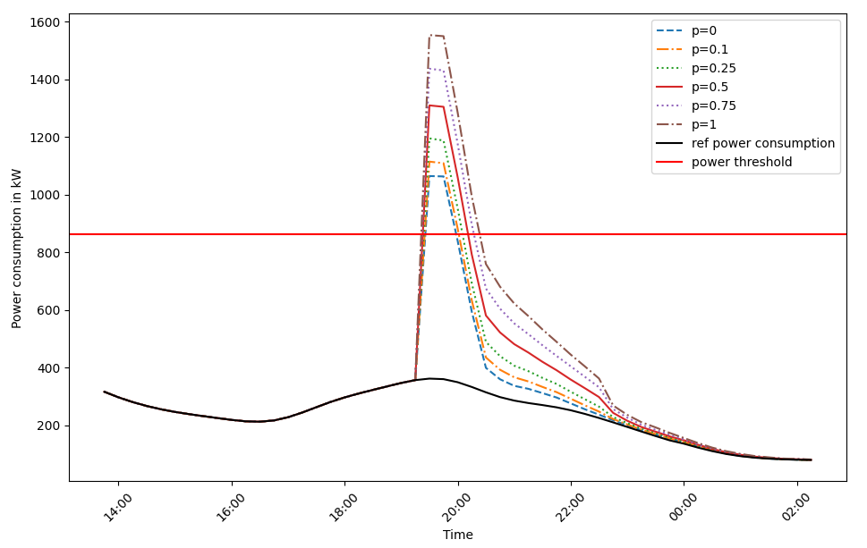
Changes in Power Consumption with a variable adoption rate for EVs
Results of the simulation model with different adoption rates p for EVs
Notes:
Another thing that we need to consider in todays society is the adoption of electric vehicles. It is of interest how the increasing adoption of technologies that are energy intensive might
Amplify the effects of social media-based changes in electricity demand
So we run our simulation with different adoption rates, keeping all other model parameters the same
You can see in the plot the resulting power consumption
We can see in the results that the power consumption increases with increasing adoption rate, reaching an increase of 150% for the peak demand

Slide 21
Conclusion
Bildquelle hier angeben

Slide 22
Conclusion
Summary
This paper proposed a framework to monitor the effects of information on the power grid.
Grid operators could use our framework to predict critical power consumption peaks caused by information on social media
Results
Our framework was able to estimate the spread of information, even with an ongoing information spread
Synchronization events caused by information on social media could be critical for the power grid
➔ Electricity peaks can be amplified with increasing adoption of energy-intensive technologies
Future Works
Research of methods to detect relevant social media events
Analysis of preemptive countermeasures for changes in power demand based on information on social media
Notes:
We proposed a framework to monitor the effects of information on the power grid.
This included both a model to simulate the impact of information on the power grid and
An algorithm to estimate information propagation parameters
We applied the framework on a theoretical scenario, where we used similar, but unrelated dataset
To analyze our framework
In total, Grid operators could use our framework to predict critical power consumption peaks caused by information on social media in advance and prepare
Appropriate countermeasures because of it

Slide 23
QuestionS?
Bildquelle hier angeben

